Slide 1
Will it try to kill you?
Musa Abbasi

Slide 2
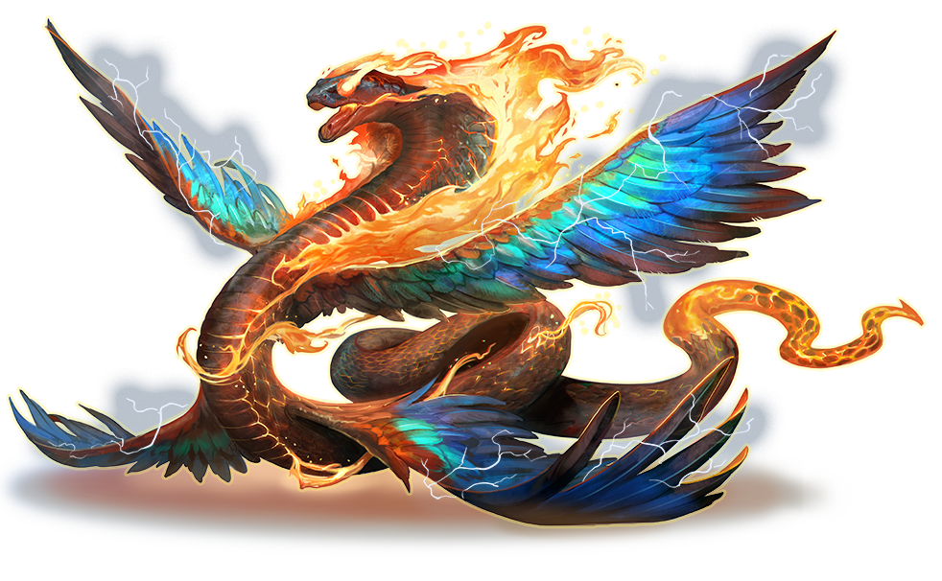
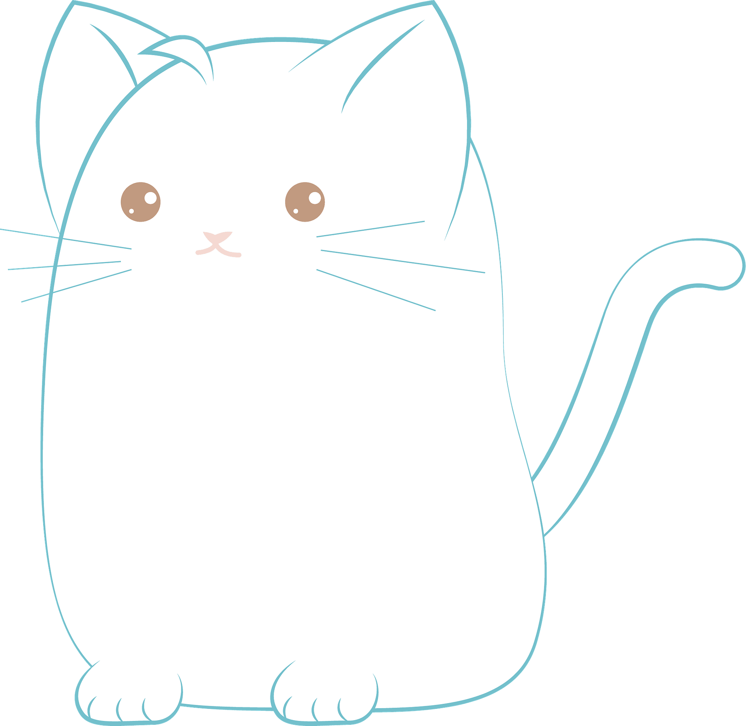
Business Problem
Pathfinder Society
Does it mean you harm?
Creatures in Golarion have all manners of appearances.
Angoyang
Xiuh Couatl

Slide 3
The Data
Created a database containing every creature known to Golarion and beyond.
Data scraped from the Archives of Nethys

Slide 4
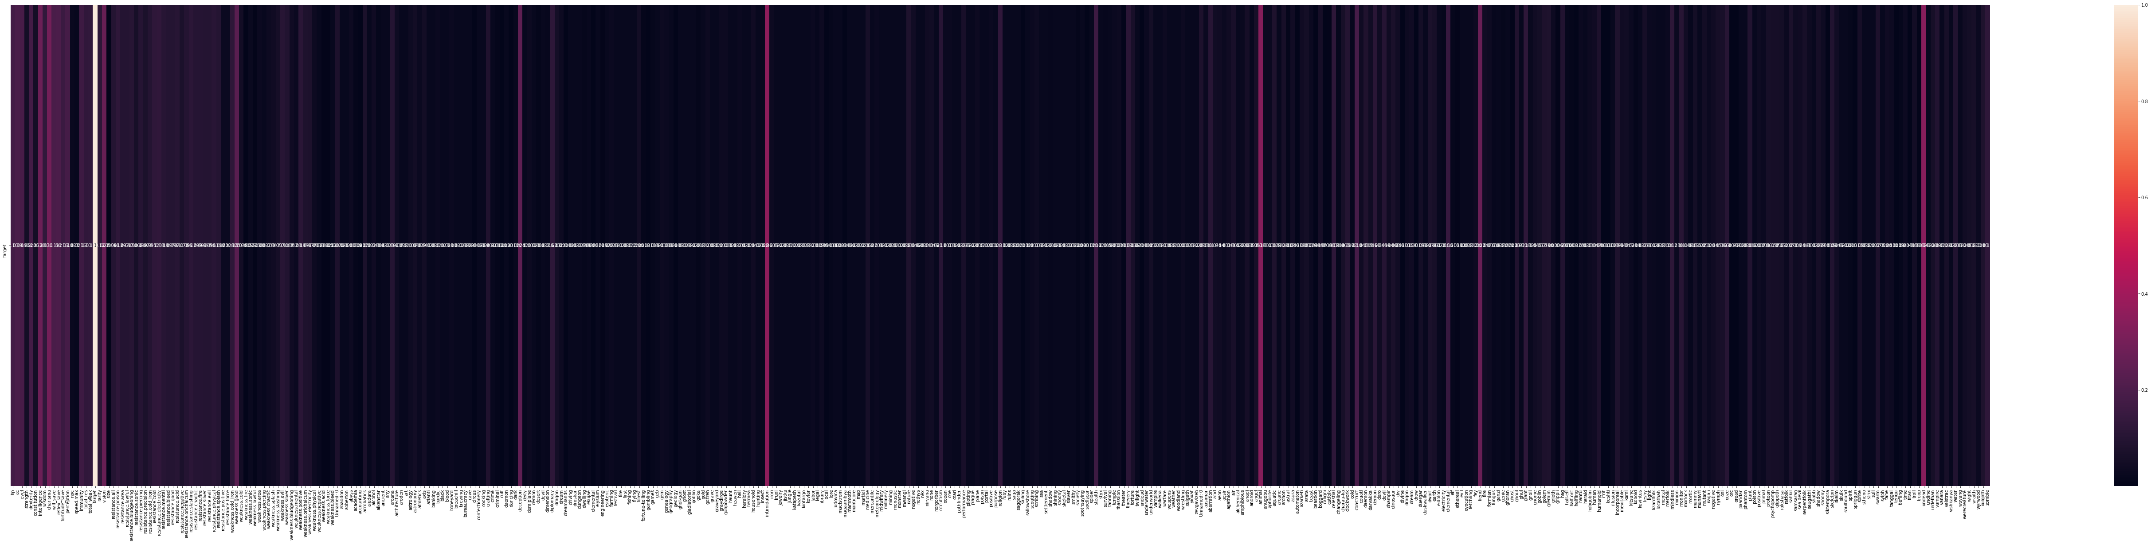
Notes:
Every possible feature, most are useless. Got rid of them.

Slide 5
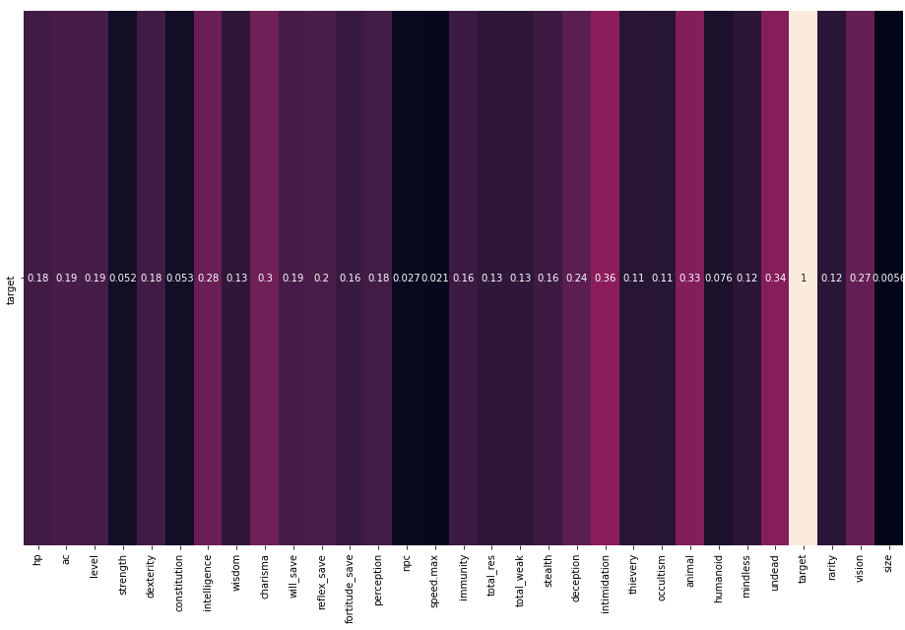
Notes:
Narrowed down to items of relevance using domain knowledge and straight numbers

Slide 6
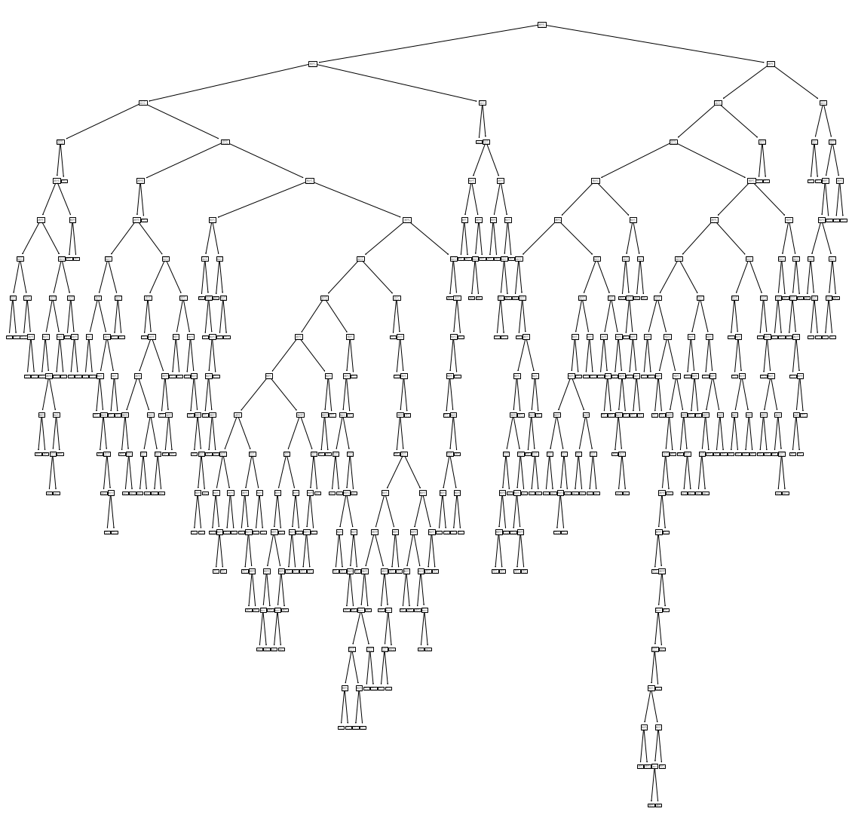
Base Model
Model Type: Decision Tree
Precision: 71
Recall: 77
Notes:
Base model with restricted selected features

Slide 7
Logistic Regression
Decision Tree
KNN
Random Forest

Slide 8
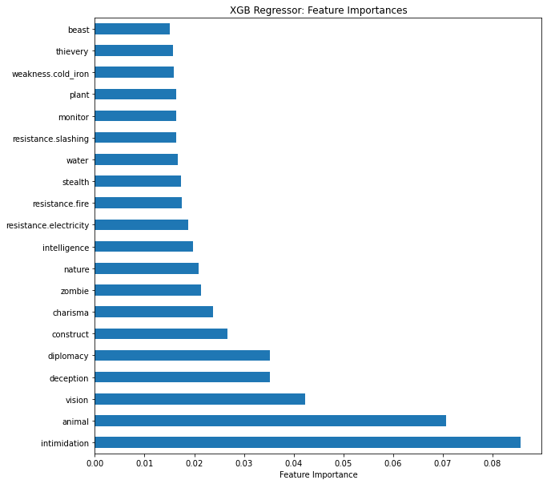
Notes:
Ran an xgbclassifier using every feature, obtained the feature importance, removed all that possessed 0 value, removed items of collinearity as well as overly obvious ones ex: weakness to good. And took the top 20

Slide 9
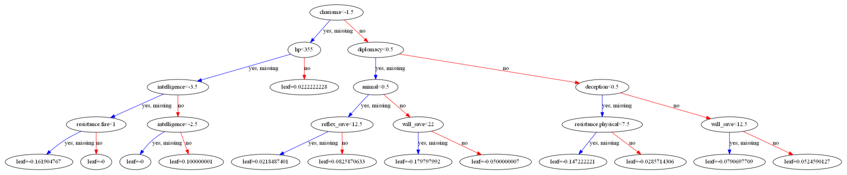
Final Model
Model Type: Gradient Boosted Decision Trees
Precision: 78
Recall: 89

Slide 10
Perception +25; dander scent (1 mile, imprecise), darkvision Languages Aklo Skills Acrobatics +27, Deception +27, Stealth +27, Survival +25 Str +3, Dex +7, Con +4, Int +5, Wis +5, Cha +7
AC 35; Fort +24, Ref +29, Will +25 HP 250
Angoyang

Slide 11
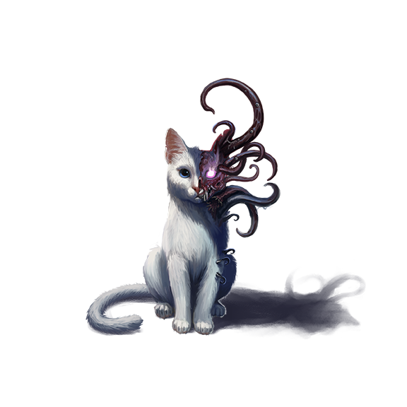
Thank you
Angoyang

